Slide 1
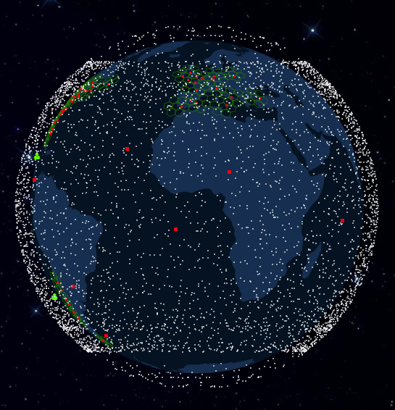
https://satellitemap.space/
Notes:
Ever seen a trail of lights moving across the sky? These white dots are location of the 7000 Starlinks: high-speed internet. We’ve been putting satellites up to nearly 70 years now: all of these went up in the last 5 years, from one company: now comprise more than half of all active satellites.
Space is getting more and more crowded: in this orbit, objects moving at 8km/second. Same LEO 10 people right now across 2 space stations! If that doesn’t convince you that this is a real change:

Slide 2
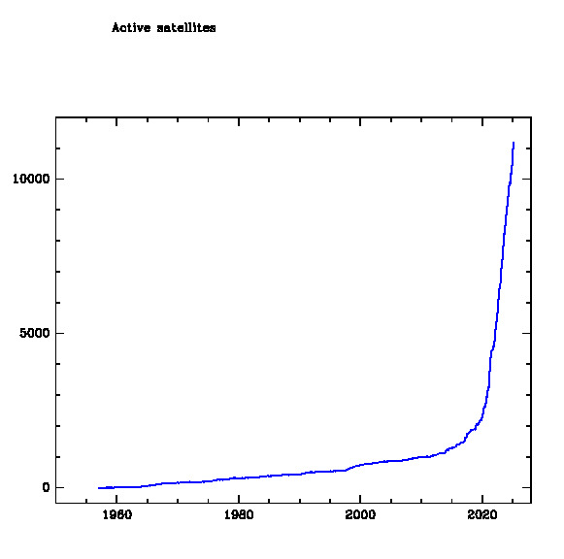
Number of active satellites
Notes:
That line is going to keep going up. At least 5,000 more Starlinks planned. Amazon and China also planning internet mega-constellations. This growth has really taken the space industry by surprise. Come off the back of a massive shift…

Slide 3
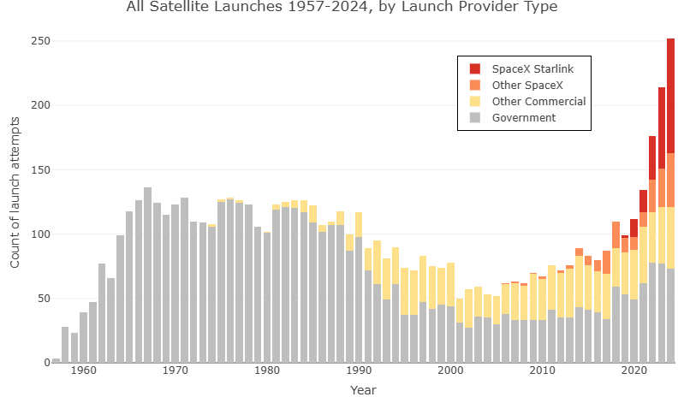
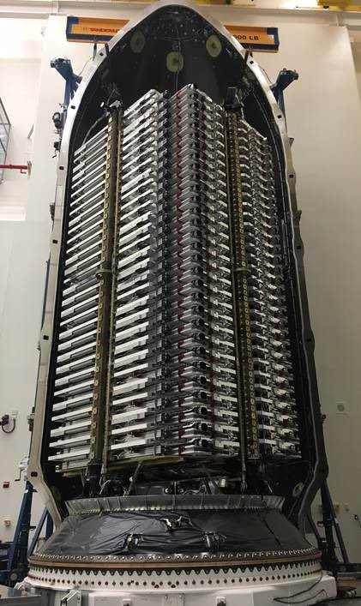
Notes:
Massive shift from government-built rockets to commercially-built ones.
Not just 1 satellite per launch: between 20 and 60.

Slide 4
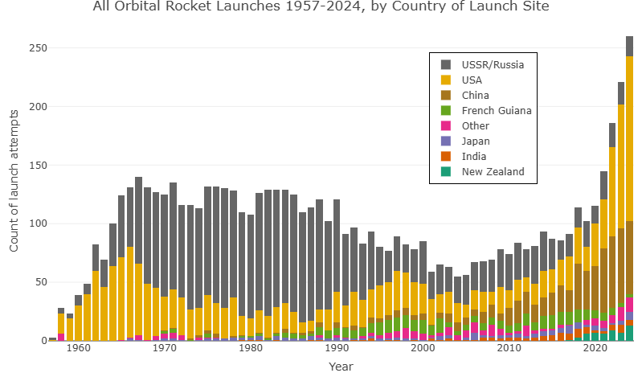
Notes:
What trends can you see?

Slide 5
Analysing the trends
Space launch capabilities have become international and commercial
As a consequence, we are sending more stuff into space than ever before
What might be some pros and cons to this increased access to space?
Notes:
Space tourism is even a reality – for the very rich.
We’ll come back to this at the end – so keep those ideas in mind.

Slide 6
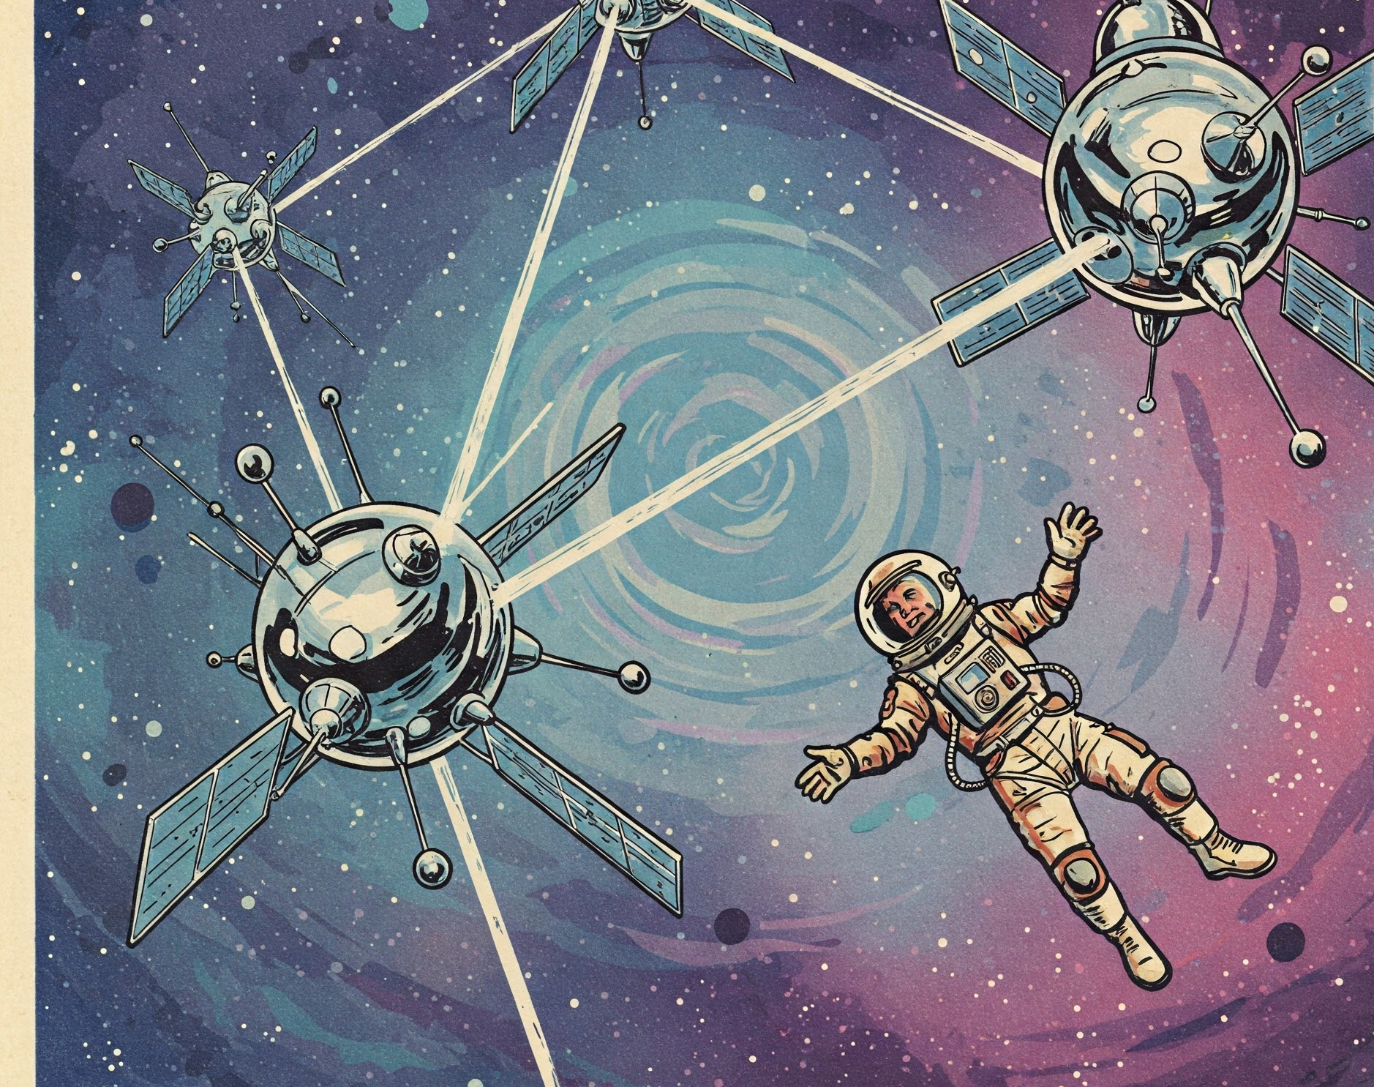
From Sputnik to Starlink A Brief History of Putting Stuff in Space
Daniel Wrench
SPCE101
February 2025
AI-generated artwork from Gemini
Notes:
In the meantime, a tour of the space age, from Sputnik to Starlink. Answer:
How has the rise of China affected US space policy?
What has made SpaceX so dominant, so quickly?
Did we really land on the Moon? (Any moon landing hoaxers here?)

Slide 7
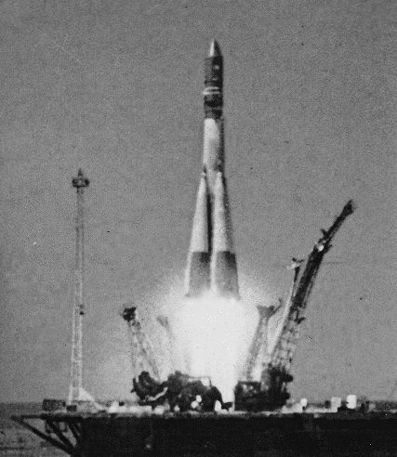
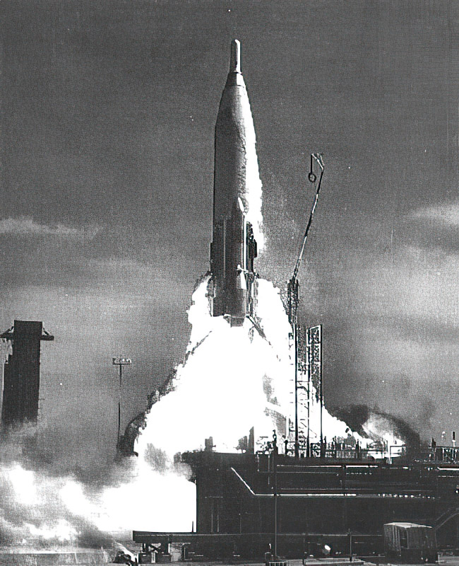
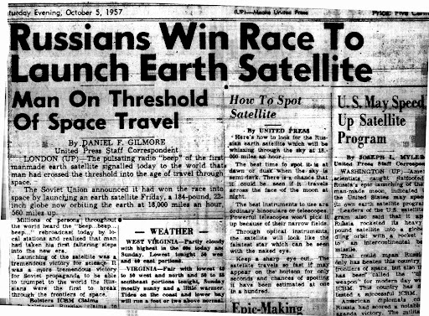
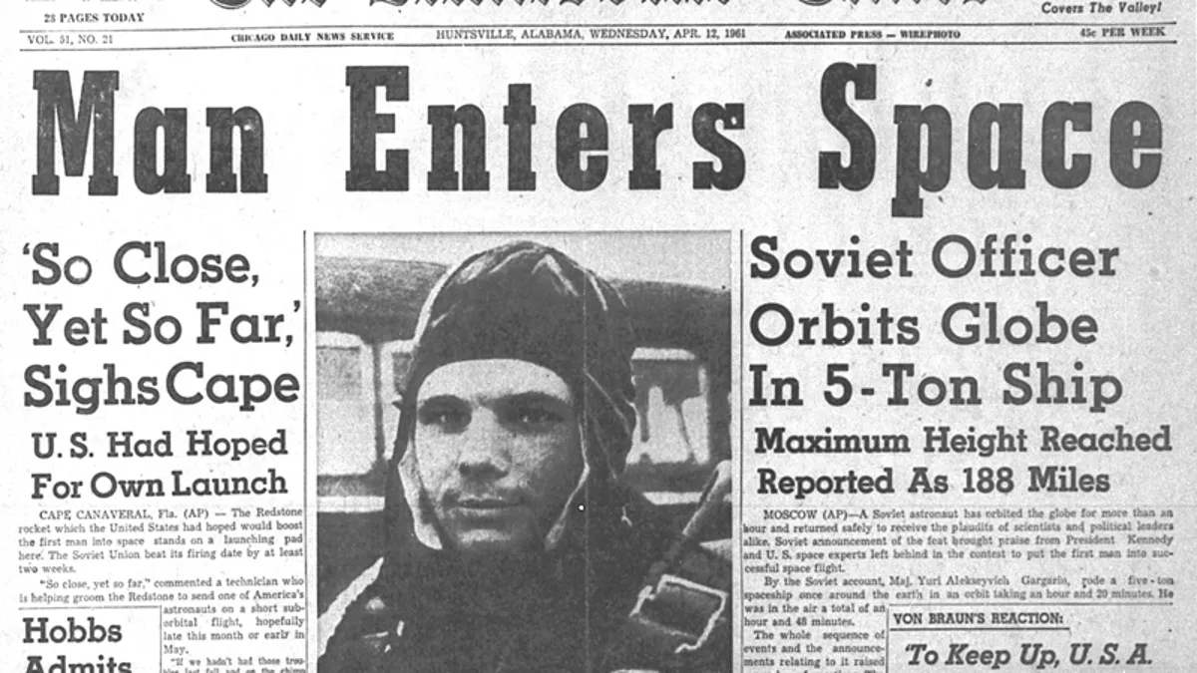

A Nuclear Rivalry becomes a Race to Space
1961
1957
Notes:
1950s: Cold War, both designing ICBMs to threaten each other with rapid delivery of nuclear weapons.
Could put stuff in space for science too! IGY a great opportunity
Sputnik, this guy. Sense of foreboding amongst the American public. Need to prove superiority not only to themselves, but also to newly independent countries

Slide 8
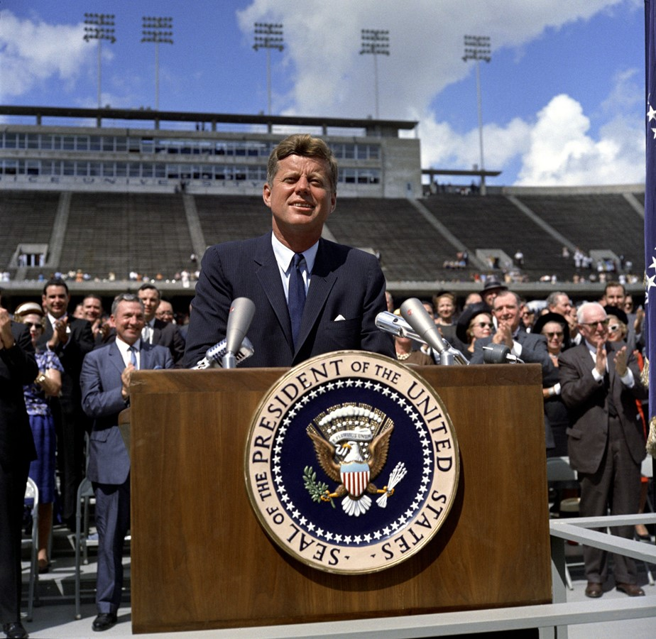

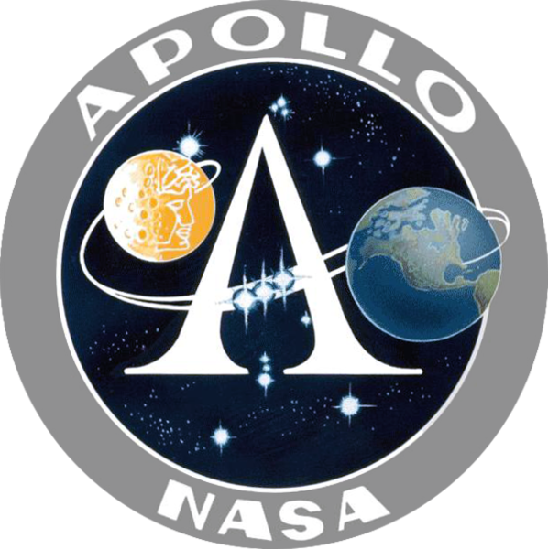
Let’s go to the Moon for knowledge and peace!
Please, let’s beat the Soviets at something
And do it before the decade is out!
1962
Notes:
So in response to this, JFK came along and moved the goalposts of the space race 400,000km away. He challenged his nation to go to the Moon – not because it was easy, and not because it was man’s destiny or scientifically valuable – but because it was hard. Specifically, hard enough that it might give them time to overtake the Soviets. A political move: but also crazy ambitious one. When he announced it, US had a grand total of 15min of spaceflight experience. And this was not going to be cheap. But geopolitics required it, and the Apollo program was born.
Source: https://www.jfklibrary.org/asset-viewer/archives/jfkwhp-1962-09-12-a#?image_identifier=JFKWHP-KN-C23643

Slide 9
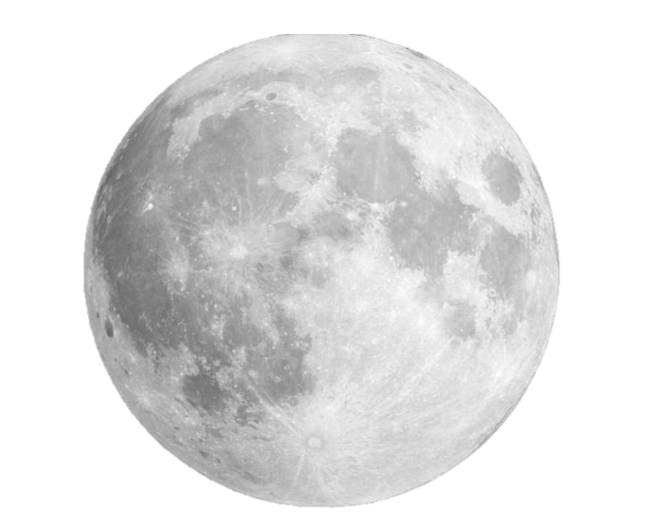
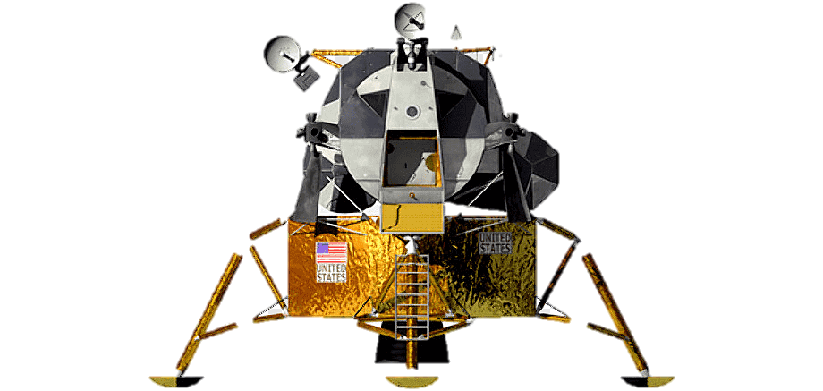
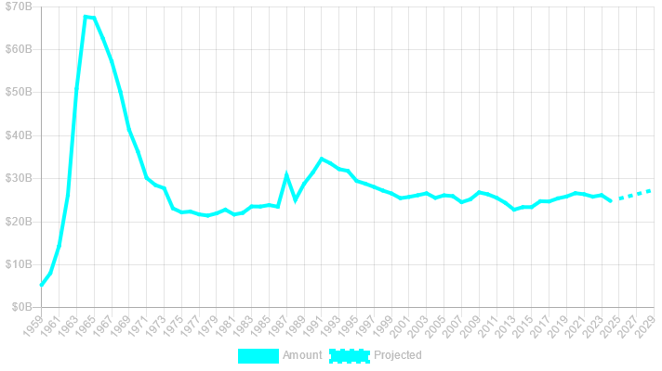
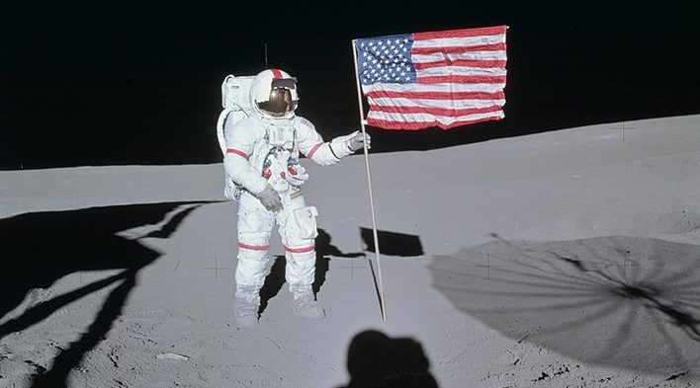
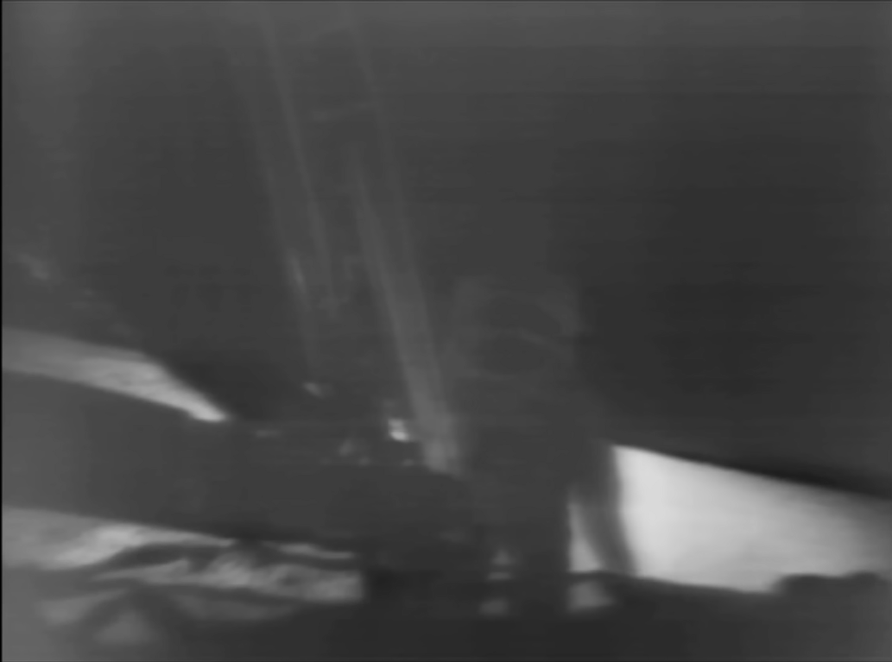
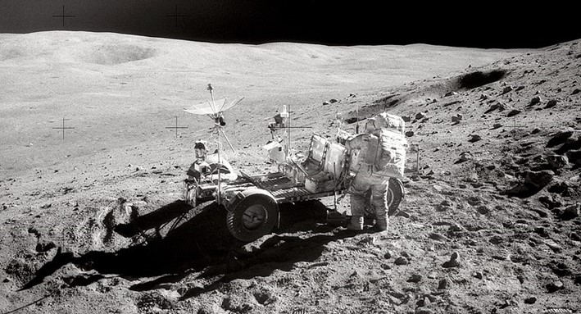
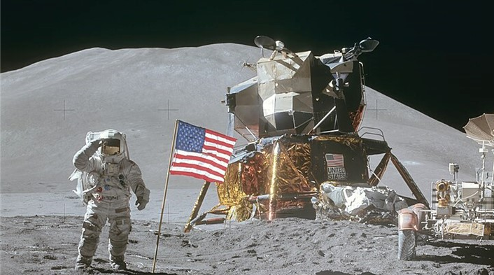
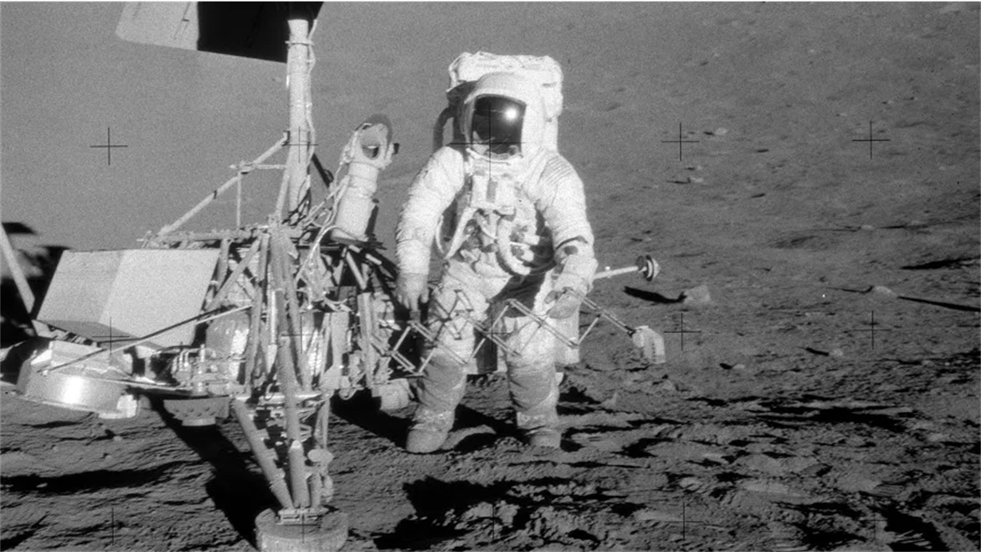
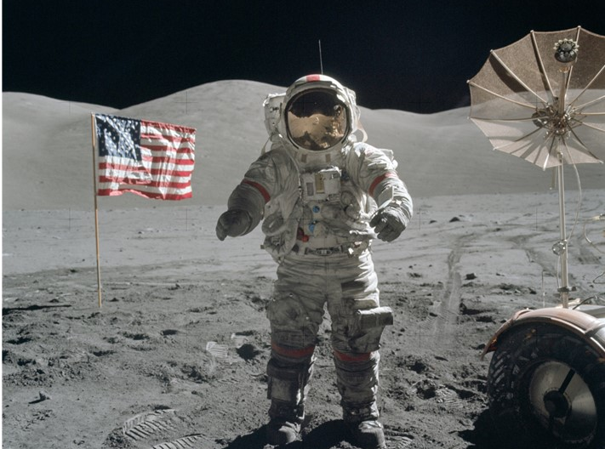
History of humans in space
November 1969
February 1971
April 1972
July 1971
December 1972
July 1969
NASA budget (USD)
Notes:
Source: https://www.planetary.org/space-policy/nasa-budget
Project Apollo was funded to the tune of $300 billion USD in today’s money. In an incredible feat of management, let alone engineering, NASA’s workforce of 300,000 met the now-dead Kennedy’s deadline with 6 months to spare. July 1969, the Eagle landed, Neil made his one small step
American taxpayer got not just one landing, but 6, out of 7 attempts. Amazing! With this momentum, surely Moon bases and people on Mars by the 1980s! Sadly not. Why? As soon as Apollo 12, people started tuning out. The public sentiment was, we’ve beaten the Russians – wasn’t even much of a competition in the end - and there was only so excited people could get about grey rocks, even ones from space.
Combine that with the Vietnam War and civil unrest, US had no appetite to continue such a costly program, and funding plummeted. No honeymoons on the moon for you.

Slide 10
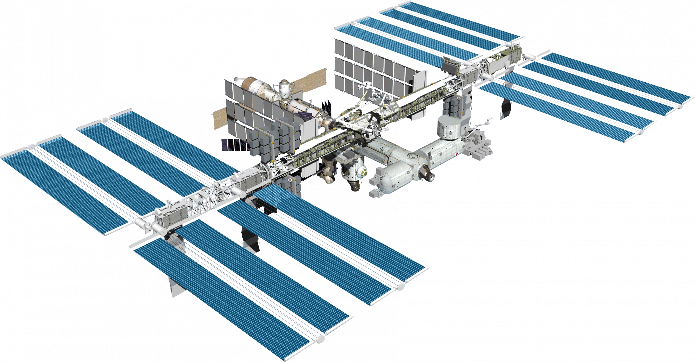
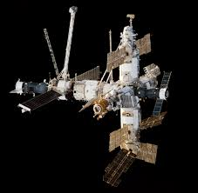

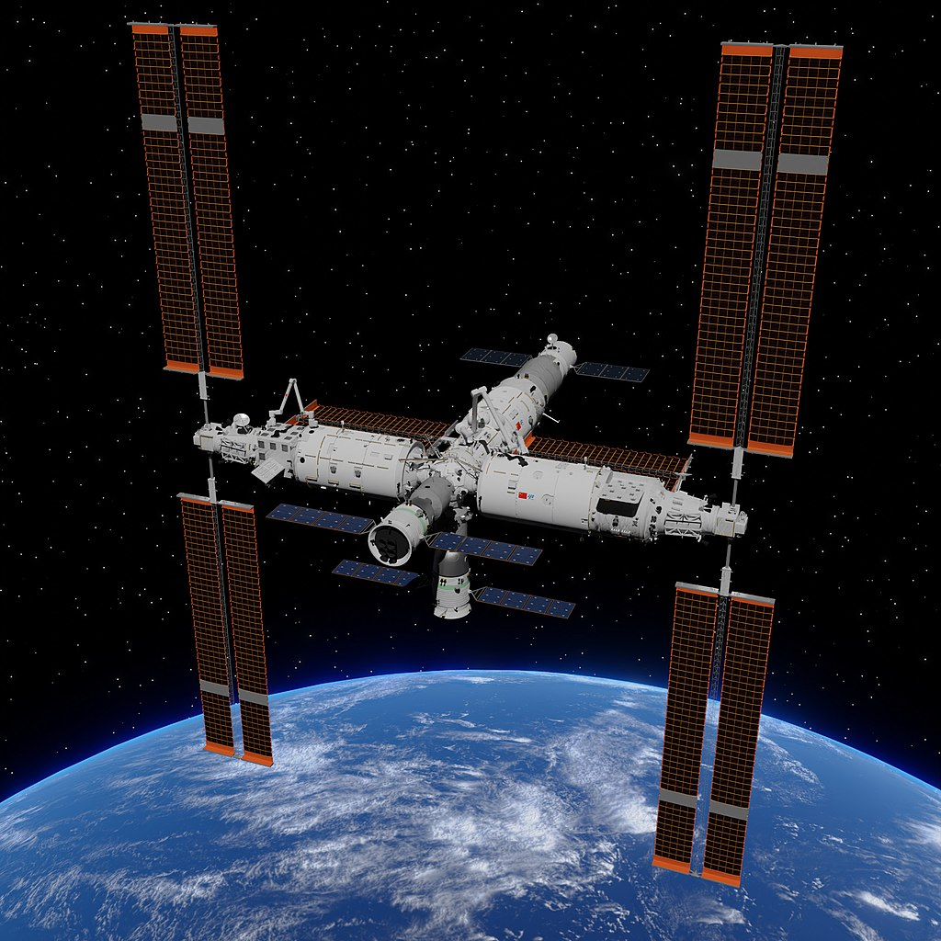
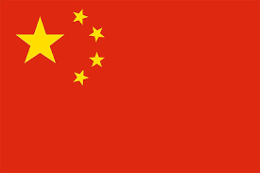
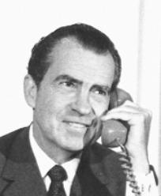
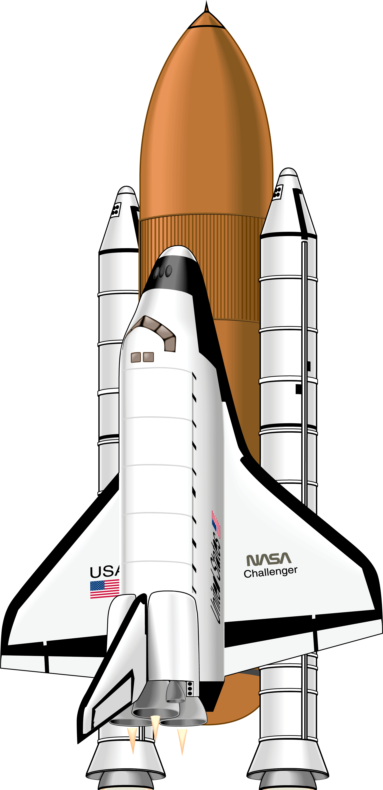
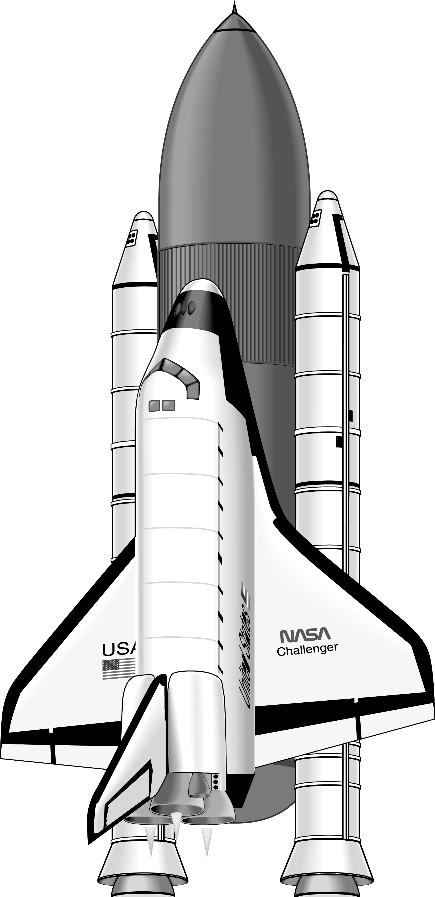
History of humans in space
~700 people 47 countries
12 moonwalkers
Apollo 1969-72
International Space Station 1998-2030?
Mir 1986-2001
NASA budget (USD)
Tiangong 2021-
Challenger 1986
Columbia 2003
Space Shuttle 1981-2011
Notes:
Source: https://www.planetary.org/space-policy/nasa-budget
After peaking at 4% of federal budget in 1965, NASA’s allocation has since hovered between 1 and ½% of all US government spending, and humans have never reached those heights since. What exactly has happened since? Nixon was the president who got to call up Neil and Buzz on the Moon, major influence on spaceflight policy for rest of century. After denying another big expensive program signed into law the space shuttle, which was supposed to be a much more economical way of accessing space. Shuttle went on to have 30-year program, crowning achievement building the ISS, now continuously occupied for more than 20 years by people from 15 countries. Including Russia and the US working together, even to this day. Russia and China have also had their own space stations over the years.
Despite this amazing contribution of building the ISS, the shuttle was by all accounts a policy failure. Supposed to provide affordable, regular and reliable access to space.

Slide 11
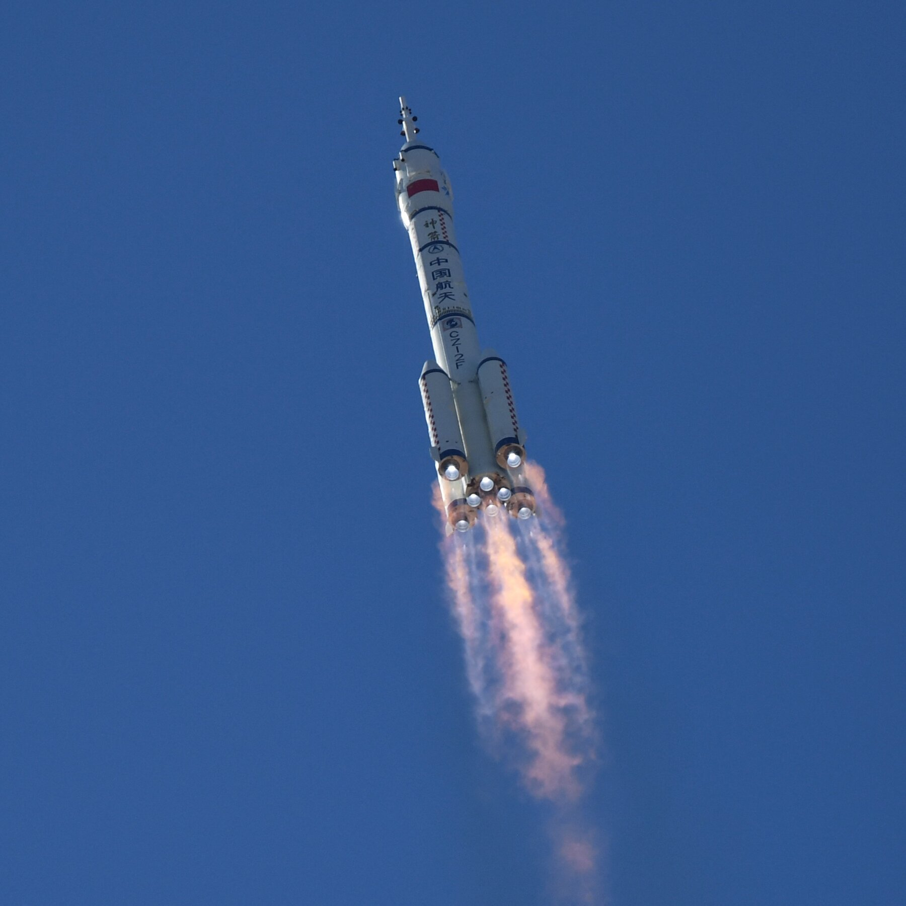
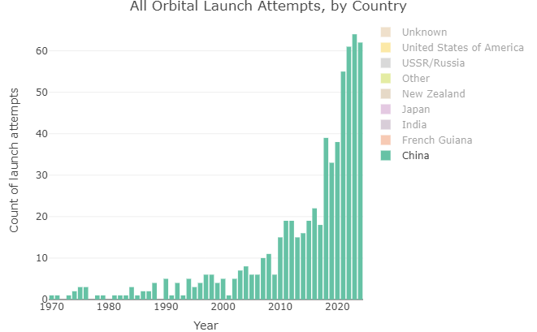

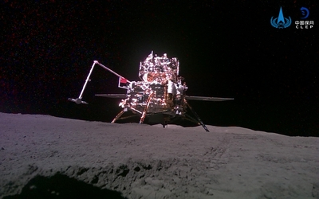
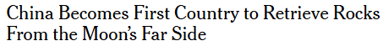
The Rise of China
Tiangong space station
Chang’e 6 lunar lander
Notes:
Operating one of 2 space stations, 1/3 size of ISS. 3 up there at the moment
100% success rate with their 4 robotic lunar landers, including Chang’e 6 which brought back the first samples from the far side of the Moon.

Slide 12
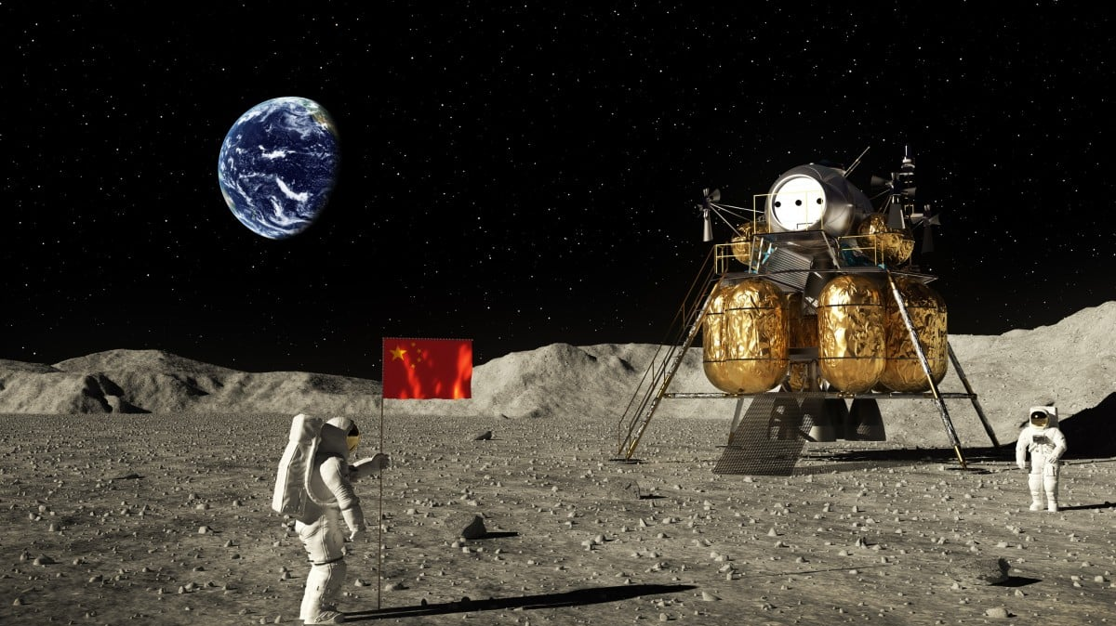
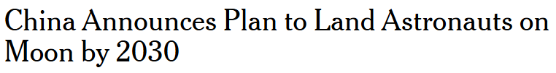
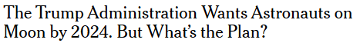
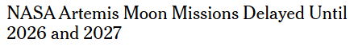
NEW YORK TIMES, 29th MAY 2023
Notes:
Lot of hype about the Moon these days: Japan and India landed for the first time recently, two landers on their way and a third launching on Thursday. Why?

Slide 13
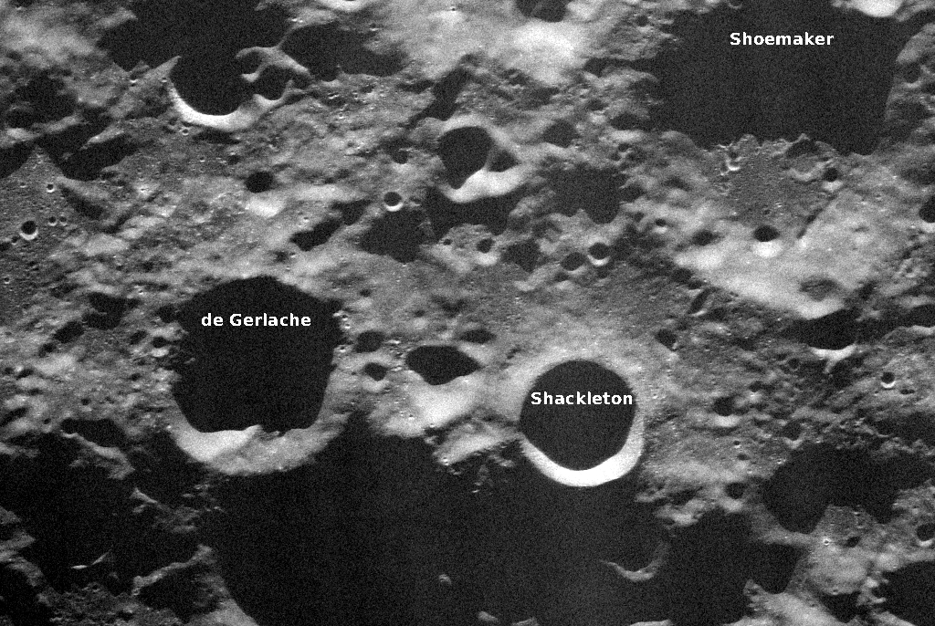
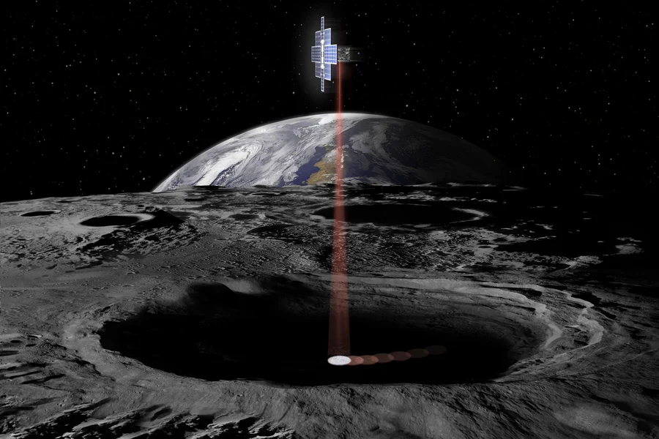

The Moon is Cool Again
H₂O!
SOUTH POLE
Notes:
Rocks that the Apollo astronauts brought back showed no sign of water: Moon must be completely dry.
However, the Moon has these craters at its poles which are permanently shadowed. Craters like Shackleton here haven’t seen the Sun for perhaps billions of years. In 2009, an Indian spacecraft called Chandrayaan-1 orbiting the Moon discovered chemical signature of water ice in these craters. This has led to a lot of excitement. Water could be a real boon for exploration and settlement: could make the Moon a pit stop on the way to the rest of the solar system. But there are still lots of unknowns: know it’s there, but don’t know how much or how easily accessible.
Therefore, in order to find out, the South Pole is the target for both the American and Chinese lunar bases.

Slide 14

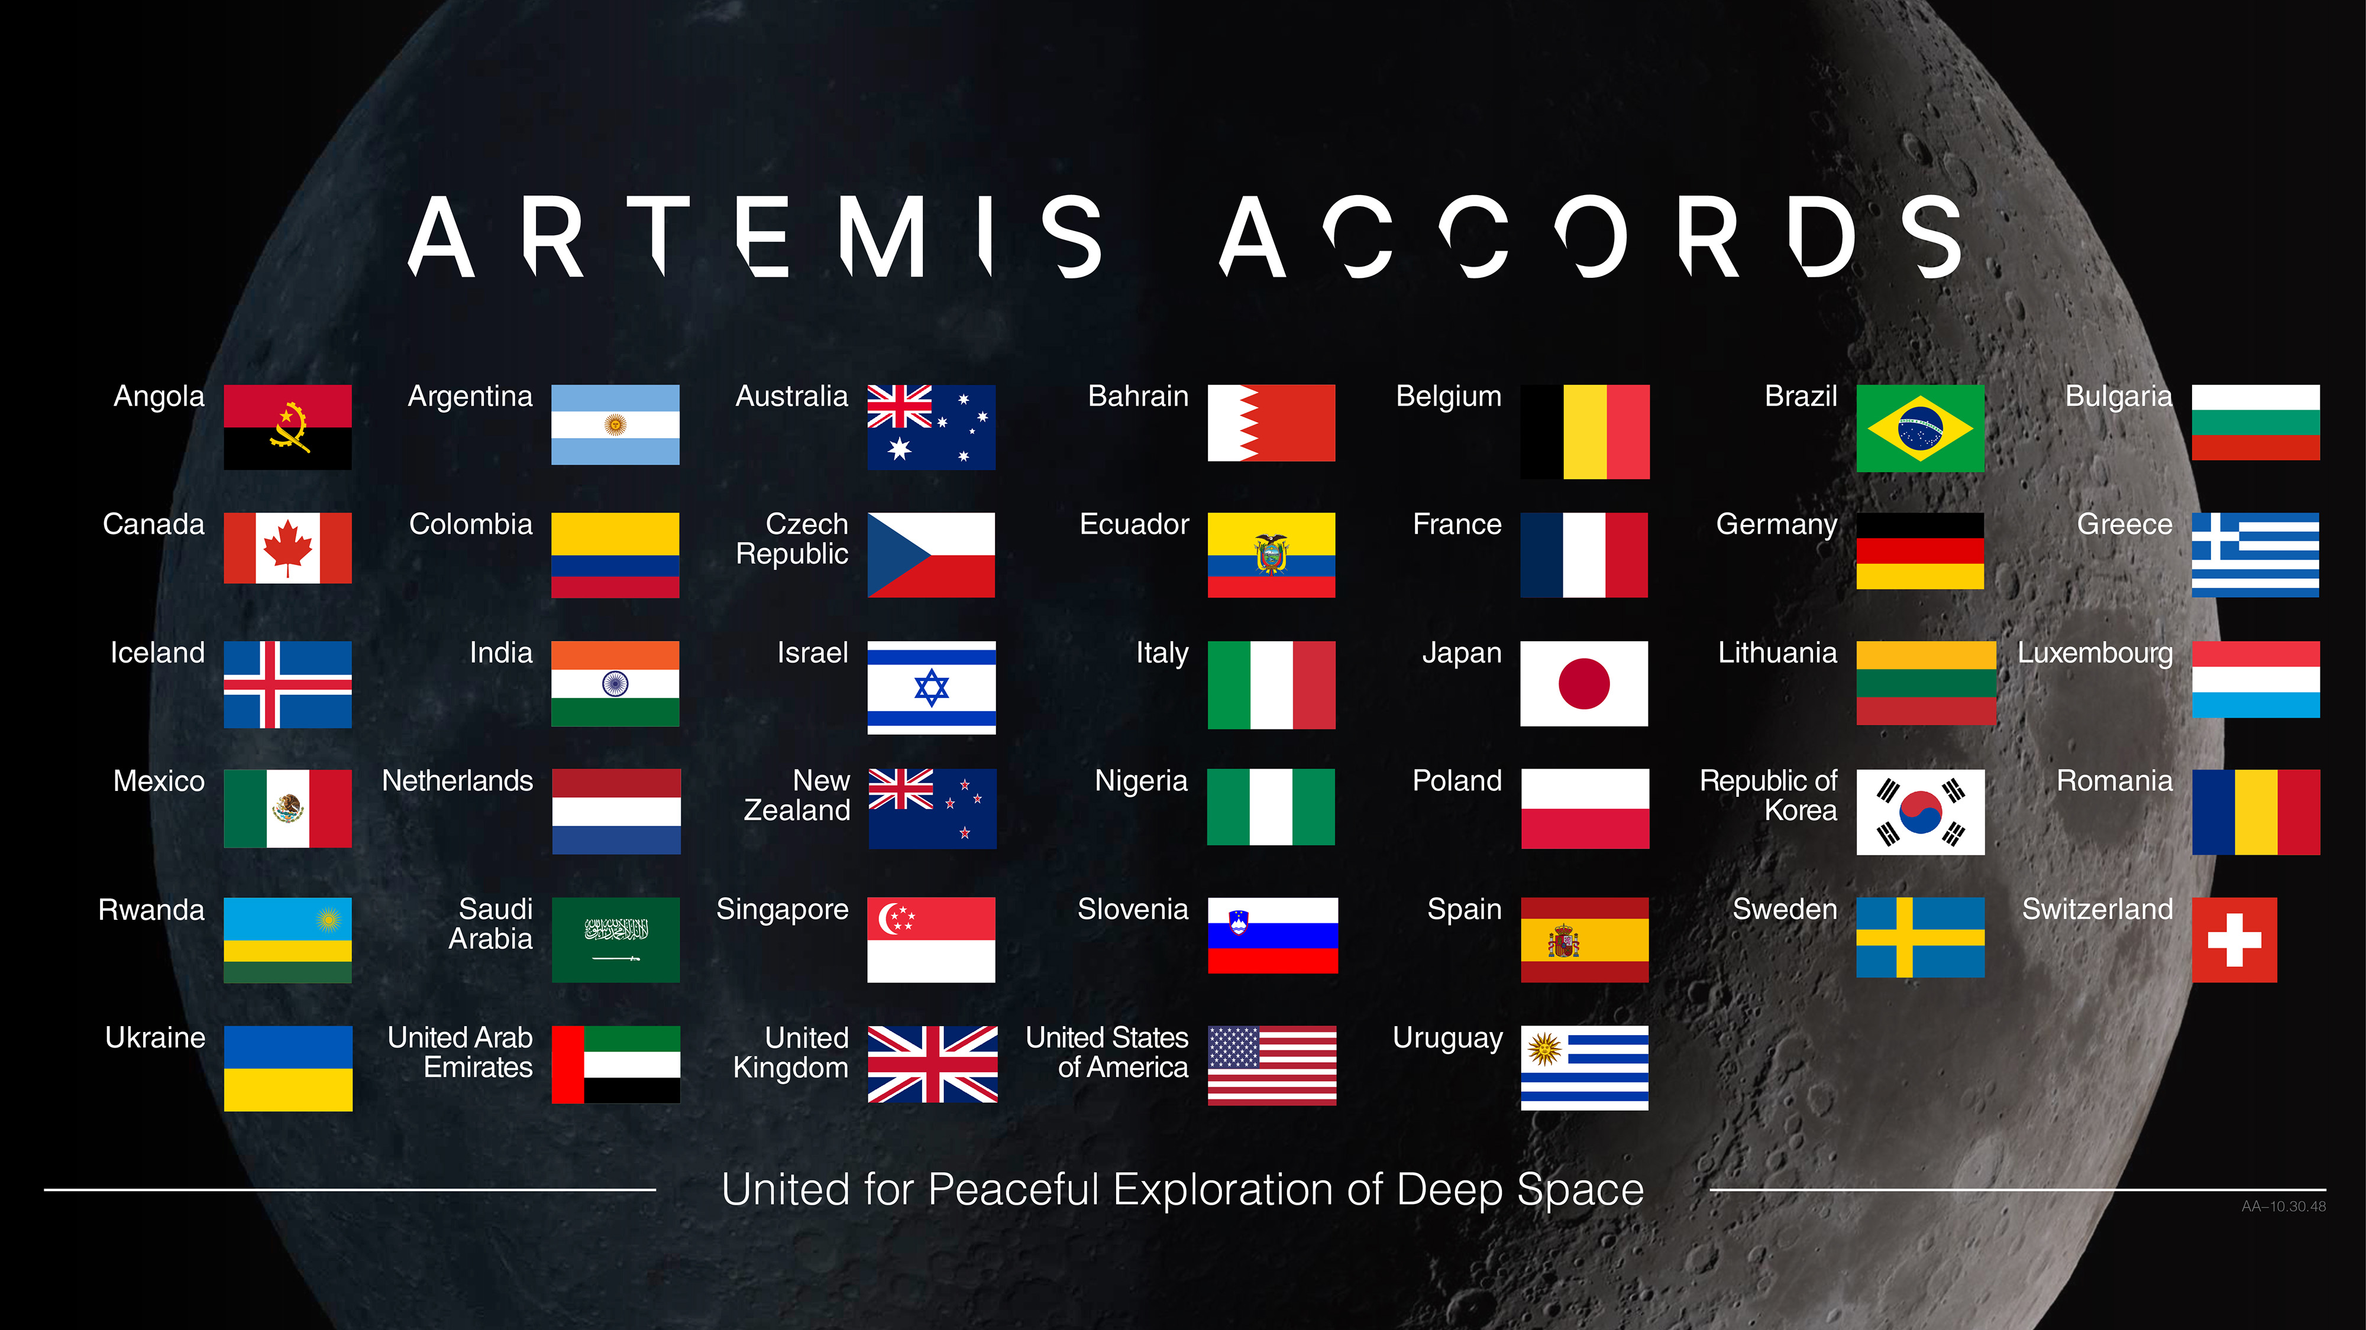
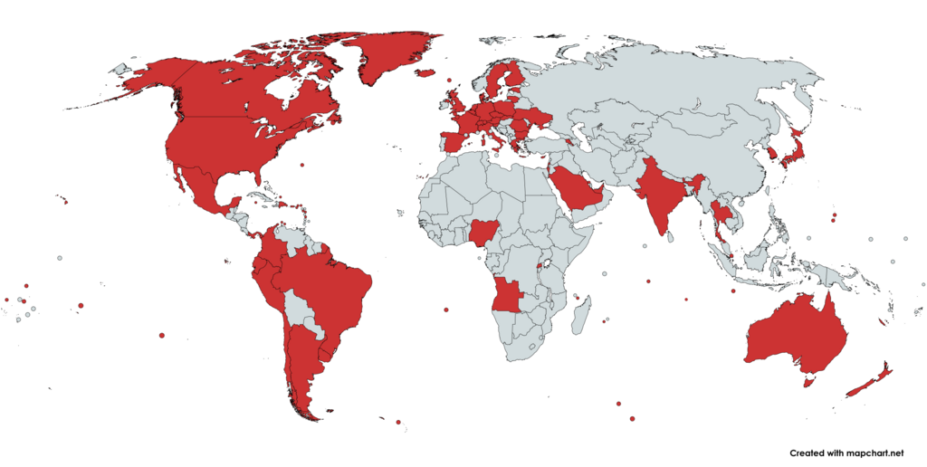
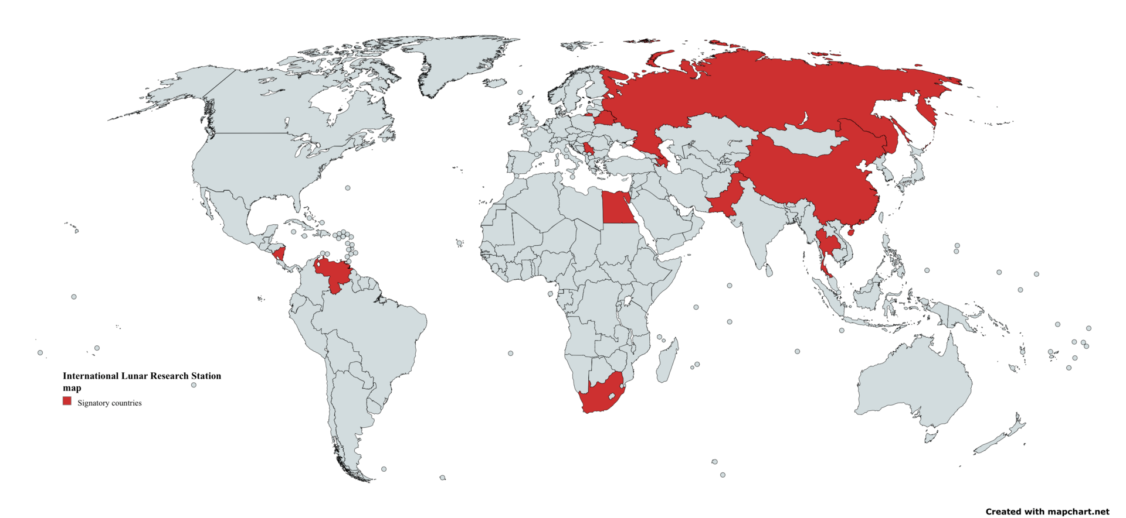
21st century space race? International cooperation and competition
International Lunar Research Station
Notes:
Space Race 2.0? Not like it was in the 60s: today, as much cooperation as it is competition.
SPD-1: going back with international partners. Been building coalition under the Artemis Accords, set of ground rules for operating on and around the Moon and Mars: 53 nations signed so far, including NZ
Meanwhile, China and Russia are gathering partners around their planned lunar base.
Interesting to note there’s a very low barrier to signing on to these agreements: more than half the signatories of the Artemis Accords have no formal space program. Clearly states take national pride in simply being associated with these endeavours. Which brings us to the big question.

Slide 15
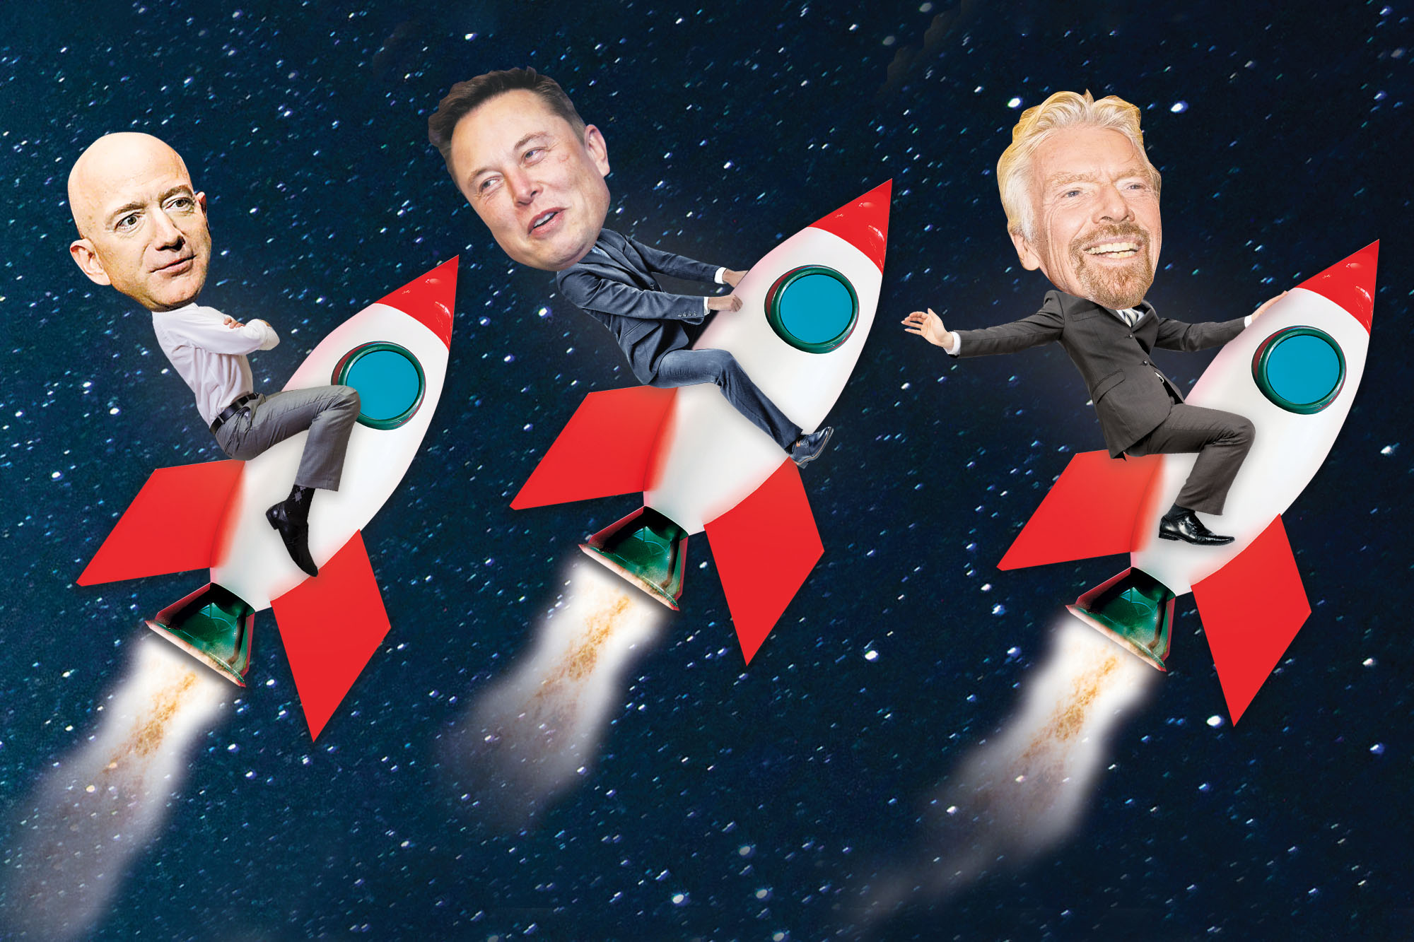
Space! What is it good for?
For making your country look cool
For spying on your enemies
For studying the Earth, Solar System, Universe
For making money???
Notes:
For a long time, there was really no business case. Now, people have found ways to make money. Made a lot easier if you have a lot of money to start off with: just ask these guys. (Accuracy of graphic) All 3 billionaires have made at least somewhat successful companies out of launching tourists or satellites

Slide 16






Buy yourself a ride to space with…
THE COMMERCIAL LAUNCH REVOLUTION
$60mill
$8mill
$500,000-1mill
Notes:
Shout out to the Kiwi companies working on spaceplanes. But it’s really been one company that has revolutionised the economics of spaceflight. Anyone know how they did that?

Slide 17
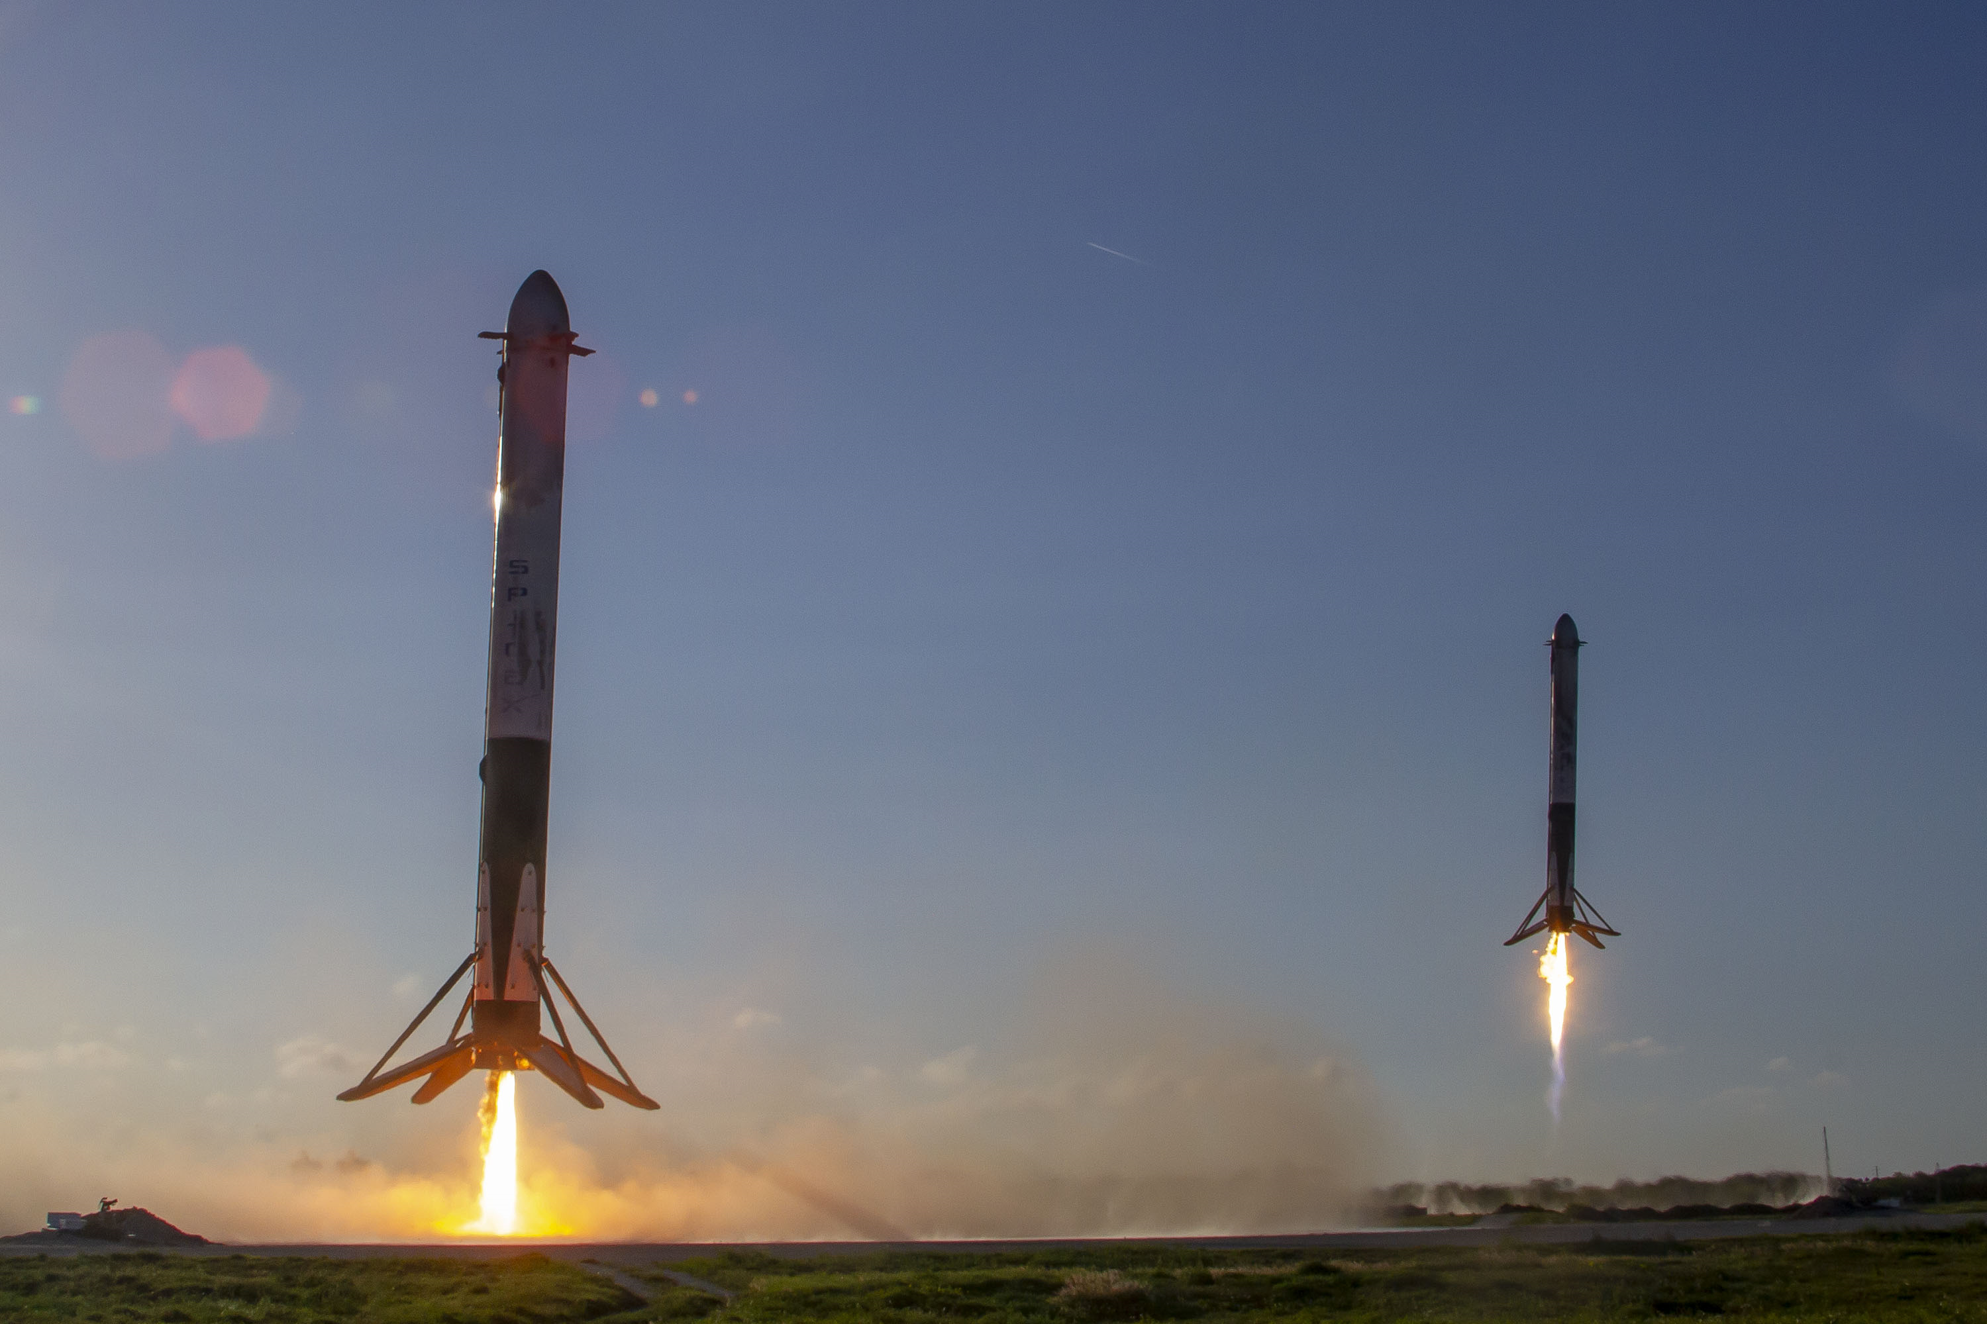
THE RISE OF
and controlled descent
^
Only rockets to re-use first stage, decreasing $/kg to orbit by 80%
4-year (and counting) monopoly on launching humans from US
Currently developing a fully and rapidly re-usable super-heavy lift vehicle…
… for transporting humans beyond low-Earth orbit
Notes:
Most technology has improved drastically since the 60s. But one area where it’s remained stubbornly retro, and therefore expensive, is rocketry. The price of sending stuff to orbit has been stuck at around $10,000kg. Until this company came along and pioneered reusability. Having landed boosters over 300 times, re-used them up to 22 times each. Resulted in massive cost reduction.
Falcon 9 as become the world’s space delivery truck for hire. Also astronauts ride to space, and the company truck: delivering more Starlinks every week, making them not only the world’s largest launch provider, but also the largest satellite operator
Funding their next big project

Slide 18

America Chooses to Go to the Moon… for better reasons this time?
Nationalism: One-up the USSR by the end of the decade
Nationalism
Beat China
Go with international partners
Put first woman and person of colour on the Moon
Scientific discovery
Ice mining?
Create a long-term presence… and use as a stepping stone to Mars
Notes:
New milestones: Not just white ex-military American men going this time.
But how are they going to get there?

Slide 19
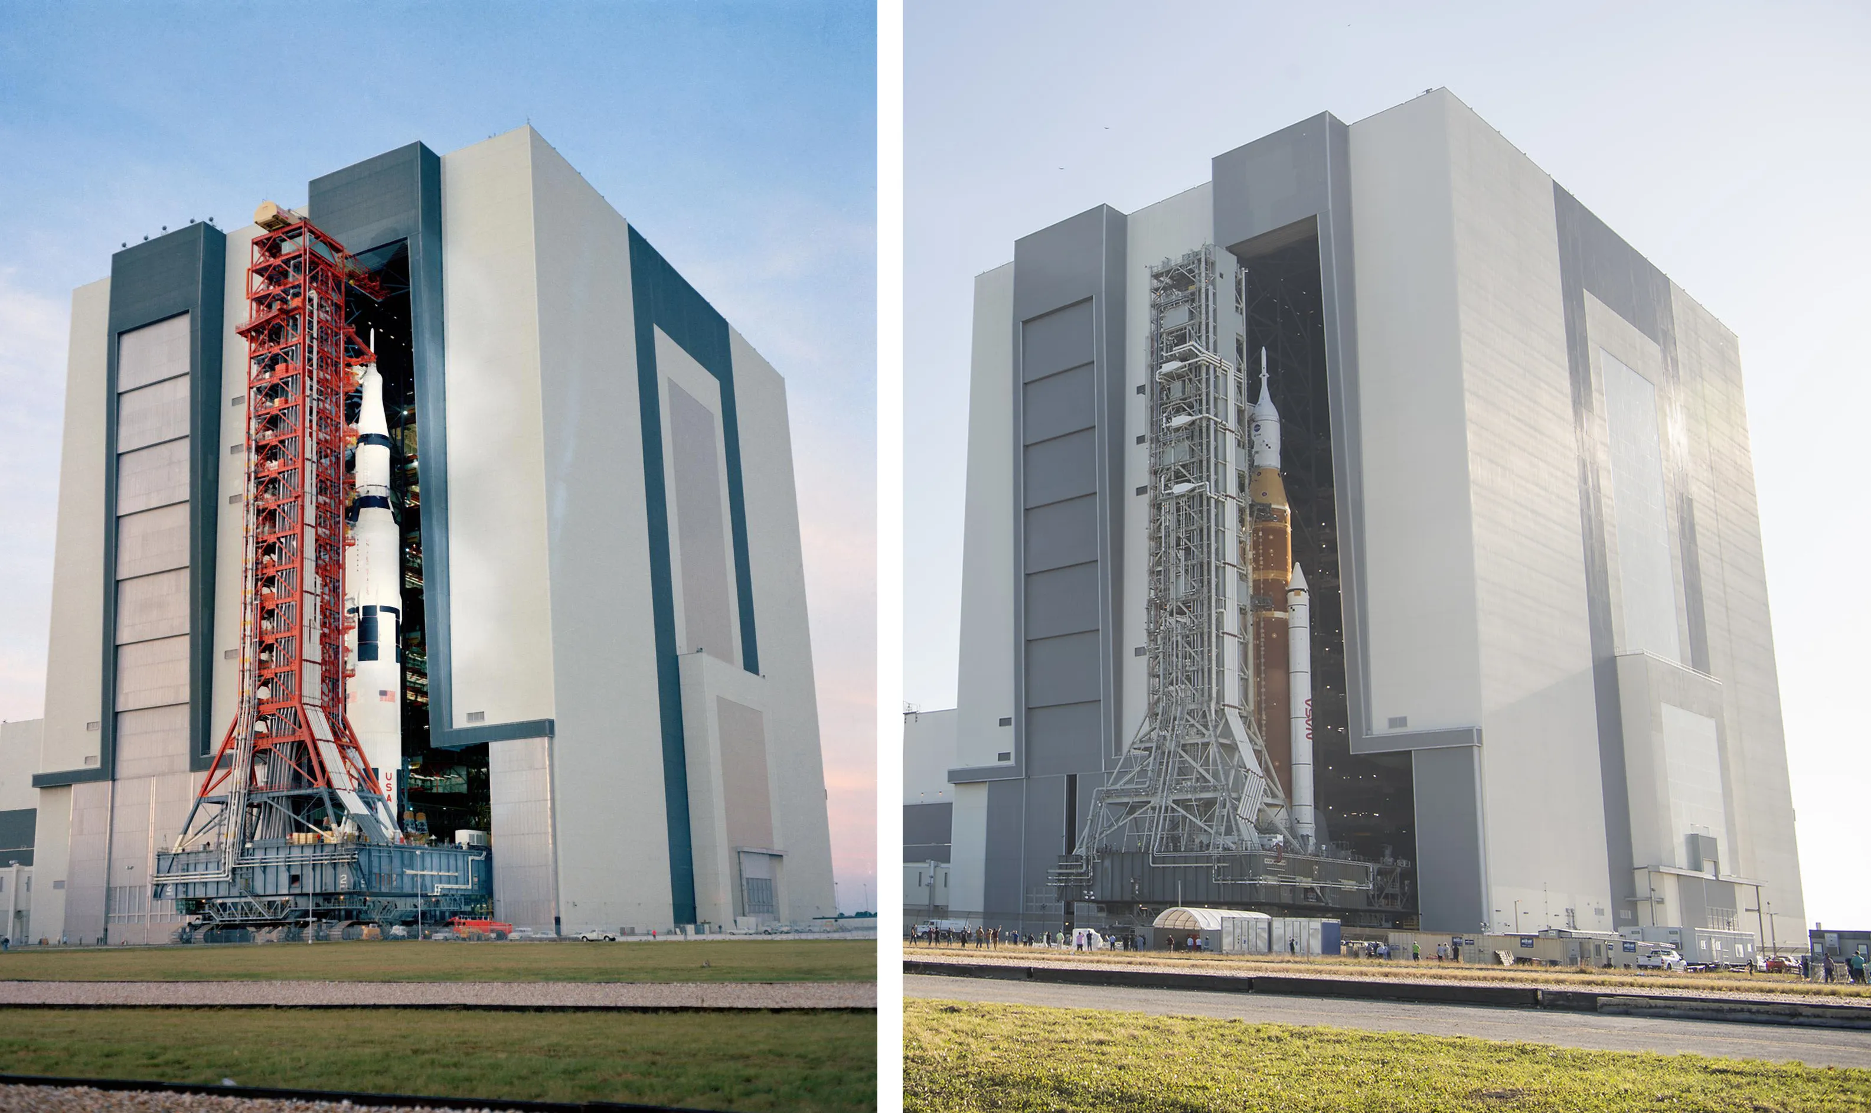

SATURN V
1971
2022
Space Launch System
Notes:
Slightly smaller rocket called Space Launch System. Still impressive, but to people in the industry incredible disappointing. Product of politics. When the shuttle was retired… to top it all off given it the most boring name you can think off. Means this rocket is actually in serious danger of being cancelled, especially given how much Trump and Elon are trying to cut costs. But until then, this is the astronaut’s ride to space.

Slide 20
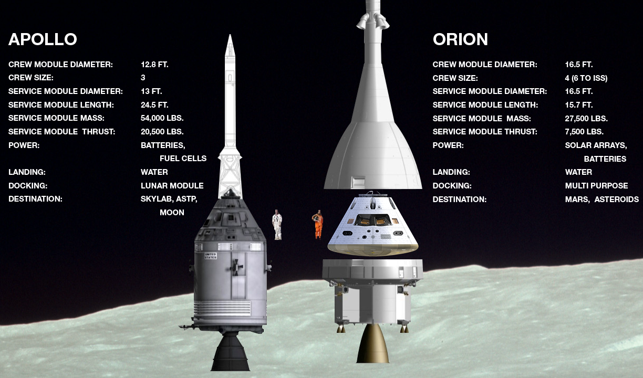
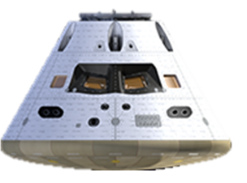
COMMAND AND SERVICE MODULE
Notes:
Life support
Apollo had the cool rocket name. Artemis has the cool capsule name. Same basic design, but it’s a bit roomier and has better computers (supposedly have improved a bit since the 60s) However, you’ll see that there are some downwards arrows on the stats. The engine for Orion, being built by the European Space Agency, is a relatively feeble, so Orion cannot get as far as the Apollo capsule did. As with the rocket, this underpowered design is the result of having years of competing priorities – something that did not plague Apollo.
But Orion also proved itself on Artemis 1…
Source: Adapted from https://www.americaspace.com/2019/11/04/artemis-updates-2019-11-03/

Slide 21
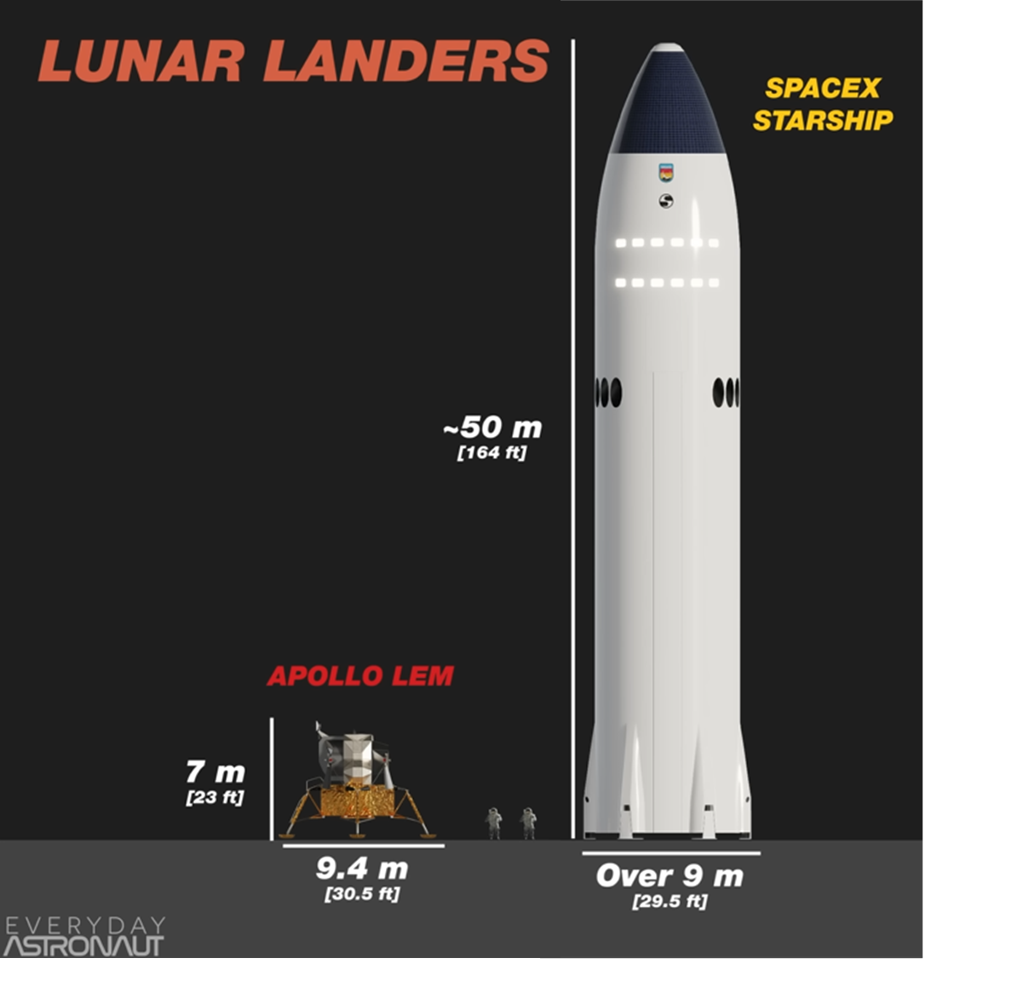
Notes:
Apollo’s lunar module was neatly tucked away inside the Saturn V, just below the command and service module. But SLS doesn’t have room for a lander, and NASA hadn’t been working on one anyway.
Under new commercial paradigm, put out a call to industry to come up with something
SpaceX were selected, being the only ones within the measly budget NASA was given from Congress.
However, you might say their proposal was slightly bigger.
Source: Everyday Astronaut YT

Slide 22
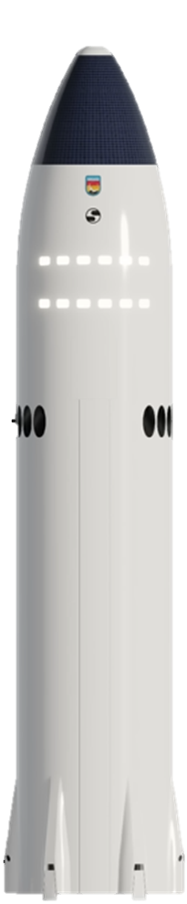

Notes:
Why so ginormous? Originally designed to send 100 people to Mars, the long-term goal of SpaceX. Just like the rest of the Artemis vehicles: really not optimised for a moon landing! But because already investing so much capital in it, SpaceX was able to offer their lander for half the price of the next cheapest option, despite being the most silly looking.
So the idea here is that Orion will dock with Starship in lunar orbit, transfer the astronauts, who will then descend to the surface. To do this, Starship needs to launch on its own rocket, which as you might expect, is also quite large.

Slide 23
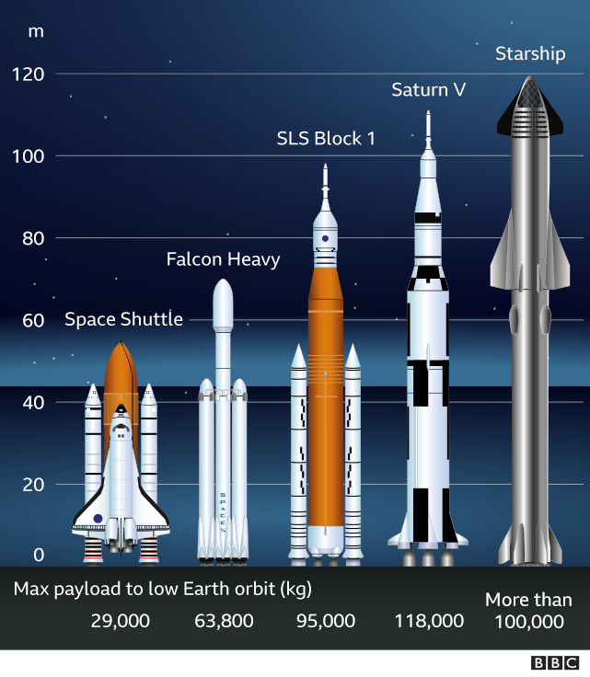
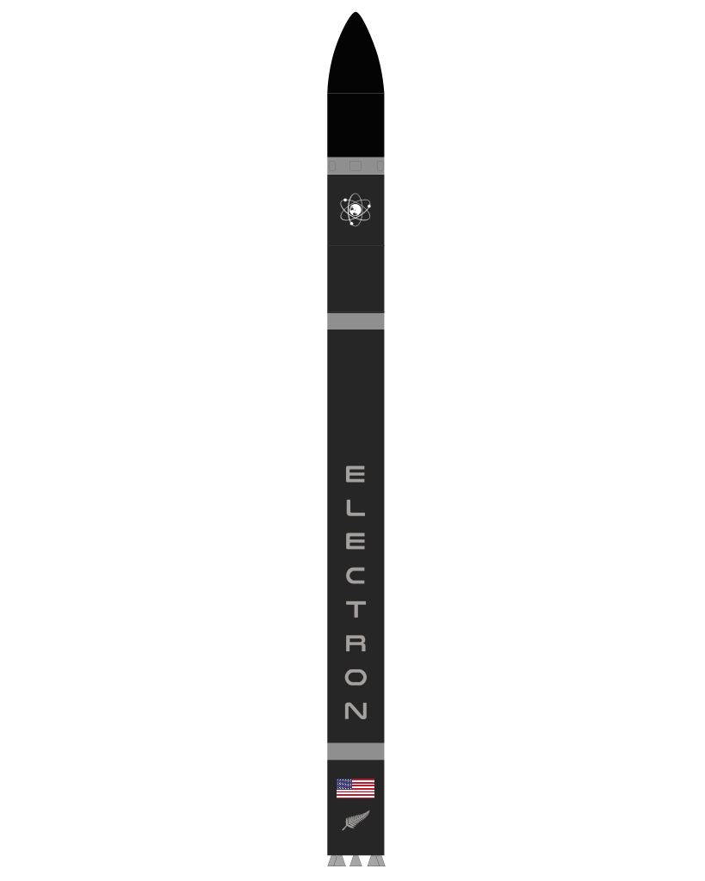
All “super heavy lift” launch vehicles to have flown
+ Electron
320
Notes:
The full Starship launch vehicle is even taller than Saturn V, double the thrust, courtesy of its 33 engines, and designed to be fully and rapidly reusable.
This system will truly change the game if it is successful, including making the fully disposable SLS redundant. But it’s not there yet.
Lander = most unproven and technically challenging part of the whole program. But SpaceX have proven they can do incredible things, and we are seeing progress.
Super heavy = >50 metric tons (shuttle qualifies if including orbiter)

Slide 24


Notes:
From their rocket factory in South Texas, they’ve actually built and tested 7 starships now.
Have been some explosions along the way, but that approach to testing is what has allowed them to iterate and improve so quickly. Led to a particularly inspiring triumph of engineering on Flight 5 late last year.

Slide 25

First catch of 70m-tall Super Heavy booster October 2024
Notes:
This time lapse shows that 70m booster section returning to the launchpad to be caught by two giant arms. This is key to rapid reusability.
Next milestones: land landings, in-orbit refuelling, and land without people on the Moon.
Only then NASA will be ready to put astronauts in it.

Slide 26


Artemis II 2026
Victor Glover Pilot
Jeremy Hansen (CSA) Mission Specialist
Christina Koch Mission Specialist
Reid Wiseman Commander
Notes:
Artemis II. Last Friday it was delayed to 2026 after damage to the heat shiel on Artemis 1 had to be investigated. 10-day trip, loop around the Moon and come back
Roughly equivalent to Apollo 8, will be first time humans will have left earth orbit in 53 years.
Already seeing diverse crew: even a Canadian! NASA will be bringing Europeans and Japanese astronauts along on future Artemis flights.
Won’t be landing yet. For that we need the third and final vehicle.

Slide 27

Artemis III 2027?
Notes:
Artemis III is planned to see the first woman on the Moon, as part of a week-long stay at the South Pole. But it’s not just the size of the lander or the diversity of the crew that has changed from Apollo. Baked into Artemis is much more ambitious plan.

Slide 28


2030s and beyond?
Habitats
Pressurised rovers
Lunar space station “Gateway”
Ice mining operation
…if we manage to solve:
Radiation shielding
Dust management
Living in 1/6th gravity
Space law??
Notes:
What NASA envisions by the 2030s is a so-called “sustainable presence”: proper base camp with habitats, pressurised rovers built by Japan. A mini space station orbiting the Moon. Expeditions into those dark craters, and, if they bring back good news, an ice mining operation. Can anyone think about any potential issues with this last proposal. Keeping in mind that we think all the ice is concentrated in one spot on the Moon?

Slide 29

Outer Space Treaty (1967)
SPACE LAW: VAGUE AND OUTDATED
Treaty on Principles Governing the Activities of States in the Exploration and Use of Outer Space, including the Moon and Other Celestial Bodies
Notes:
The only international treaty relating to space that has actually been signed by all nations that have been to space. Jeff Bezos could park on Shackleton crater, melt all the ice, fuel up his rocket with every last drop – and as long as he never claimed that territory for the US: he would not be breaking the law.

Slide 30


Artemis Accords (2020) Principles for Cooperation in the Civil Exploration and Use of the Moon, Mars, Comets, and Asteroids for Peaceful Purposes
SPACE LAW: VAGUE AND OUTDATED
Notes:
Safety zones: China could land on some valuable real estate and over some undefined radius: keep out. Sensible… but effectively the same as territory? Big “finders keepers” motivation. Lot of important work for lawyers and diplomats to figure this out.

Slide 31



















Notes:
So as we’ve gone from Sputnik to Starlink, hopefully you’ve realised that space is very busy these days, with no sign of slowing down. Things aren’t as black and white as they were in the 60s: not longer just about two superpowers flexing on each other. There are now so many more players in the space game, with different motivations and morals and very little regulation to constrain them. This brings us back to the pros and cons of this new era.

Slide 32


More space = more good?
Good things
More connected world
More inspiration
Bad things
Environmental impact
Potential for conflict
Over-enthusiasm for Martian colonies: see great book
More science and technology
Notes:
Starlink is connecting communities that have never had high-speed internet, including rural areas in NZ, as well as places affected by war and natural disasters. With cheaper launches, we can have more science missions, and develop technologies that help life here on Earth. For the first time in 50 years, there is momentum around pushing humanity beyond low-earth orbit: and this time, not stopping, but setting up a lunar base and taking that next giant leap to Mars.
But we also can’t get too caught up in the excitement and romance of the final frontier. All these satellite megaconstellations are making earth orbit rather crowded, not to mention polluting the night sky. There is real potential for conflict over Earth orbit and resources on the Moon without adequate space traffic management and space law that all states can agree upon. And as for Mars: I’m all for sending people there to visit, but when it comes to building a self-sustaining colony anytime soon: there is so much we don’t know about keeping humans alive in deep space for the long-term: radiation, growing food, raising children, governing an off-world society. These challenges are all made abundantly clear in this book which I would highly recommend: very accessible and entertaining.

Slide 33

More space = more good?
Good things for NZ?
More connected world
More inspiration
Bad things for NZ?
Environmental impact
Potential for conflict
Over-enthusiasm for Martian colonies: see great book
More science and technology
Notes:
We can’t escape this debate in NZ: Kiwi farmers use Starlink, we have signed the Artemis Accords, we are home to one of two successful private rocket companies in the world, we have internationally-recognised dark skies we want to protect, we have amazing space researchers at our universities who should probably have a say in all of this.
So this is the challenge, the contradiction that Aotearoa and the world needs you to figure out. Hopefully through this course you’ll be better equipped to do that.

Slide 34

“We set sail on this new sea because there is new knowledge to be gained, and new rights to be won, and they must be won and used for the progress of all people.”
John F. Kennedy Rice University, Texas, 1962
“For space science, like nuclear science and all technology, has no conscience of its own.”
Notes:
Go back to that absolute banger of a speech that JFK gave where he challenged his nation to go the Moon. He also said…

Slide 35



Watch spacecraft launch to the Moon Thursday 1pm
Watch launch live on NASA YT channel
Falcon 9 booster landing 8min after launch
Robot landing on Moon one week later
Notes:
A private company will be launching to the Moon later this week with NASA science instruments onboard.
Drill and mass spectrometer to investigate lunar ice beneath the surface.
All to gather important data before astronauts land in the coming years.

Slide 36

















The Moon is a Harsh Mistress Robotic landing attempts so far this century
5 successes
2 partial
5 failures
☑
☑
⮽
⮽
☑
⮽
☑
⮽
☑
⮽
☑
☑
Notes:
Here’s the scoresheet of the lunar renaissance. While China is 4 from 4, the other missions so far this century have been a real mixed bag: just over half have made it in one piece. Among those have been Japan and India for the first time, as well as the first private company, Intuitive Machines, who were contracted by NASA to deliver scientific instruments to the Moon. Partnering with the private industry is an important strategy at NASA these days.
This brings us to the second game-changer for Artemis.

Slide 37




Entrance to lava tube in Mare Tranquilitatis
Rille in Aristarchus Plateau
Mountain range in Zeeman crater (as tall as Everest)
Reiner Gamma lunar swirl
Notes:
but it does have some cool features that we should go and check out. Including these fascinating, and potentially very useful, formations called lava tubes: essentially giant caves formed by the passage of molten rock, that could provide effect shielding against radiation and provide a more stable temperature.
The Moon’s main scientific value is as a time capsule of the early solar system: contains rocks billions of years old, rocks that would have since been recycled countless times on Earth by erosion and plate tectonics. Processes that simply aren’t active on the Moon. And it’s not just geology: there’s real potential make breakthroughs in astronomy by putting telescopes on the farside of the Moon.
So that’s the science and potential resource utilisation that are the final part of the motivation for going this time around. Which, brings us to second question underlying a space program: how do we get there?
Clockwise from top left: pit entrance to lava tube in Mare Tranquillitatis, rille in Aristarchus Plateau, Reiner Gamma swirl, Zeeman Mons (8km, almost as tall as Everest)

Slide 38




Apollo XI-XVII 1969-72
6 landings
12 moonwalkers
80 hours on the surface
90km traversed
400kg of rocks collected
2 golf balls hit
Notes:
Diary of those six landings. Essentially a series of short camping trips
Plant flag, pick up rocks, do some science experiments, try not to fall over
Later missions: go for a drive, pick up some more interesting rocks from further away
Then they packed up and came home, after no more than 3 days. Solar flare transition, using regolith as shielding. Radiation a much bigger problem for the Moon than Mars
But Artemis has much bigger plans: not just the giant landers
https://www.britannica.com/place/Moon/Lunar-rocks-and-soil
Alan Shephard hit a golf ball 40 yards on Apollo14

